Slide 1
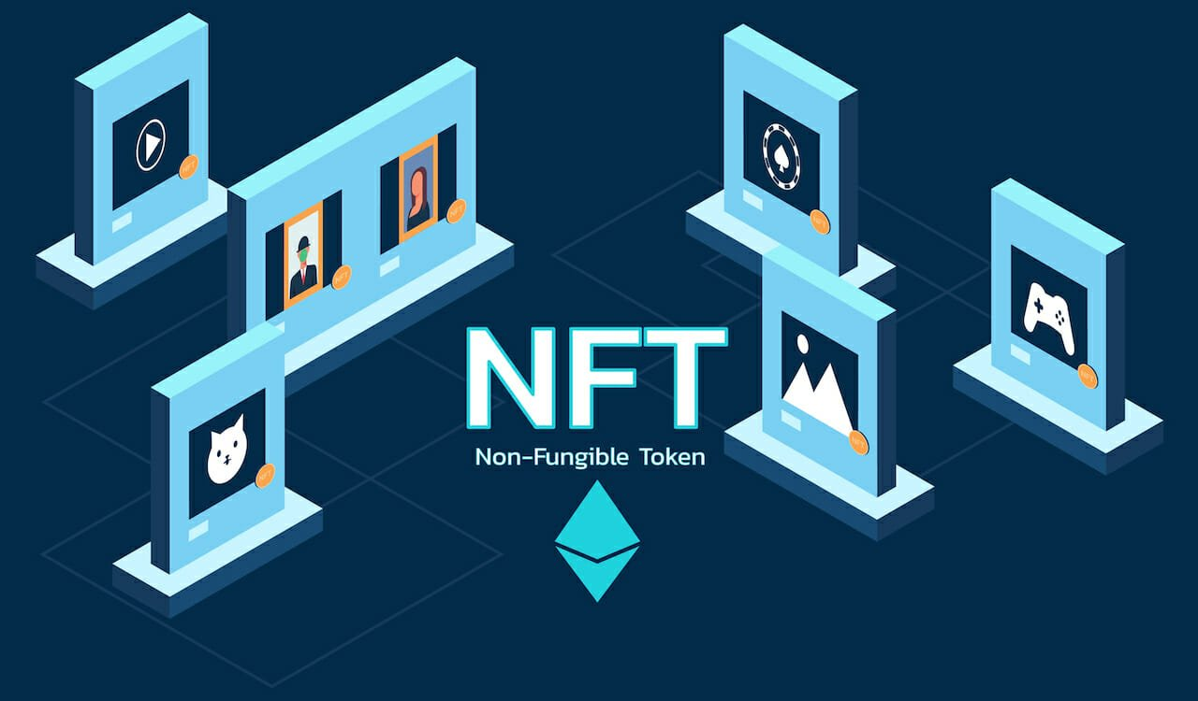


NFT Twitter Sentiment Analysis
University of Toronto
FinTech Boot-Camp
Project 2 - June 20, 2022
Team Members:
Chantal Garnett
Sameer Lakhe
Emiliano Mendez
Marcus Policicchio

Slide 2
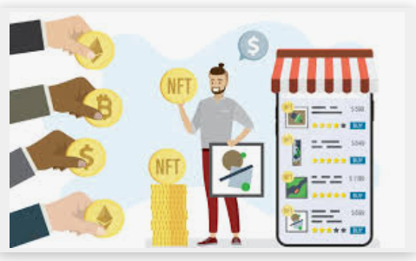
Meet our typical user, John: A young professional who has $10 000 CAD to invest in the new emerging volatile market of NFTs. However, John knows very little about NFTs and even less about where to begin.
The NFT Price Tracker
The NFT Price Tracker will:
Track and predict future NFT prices for 30 days based on average prices for 5 popular NFT collections over 6-months.
Calculate the amount of ETH needed to purchase a particular NFT collection.
Compare and forecast NFT valuations.
Show the total number of sales for each collection.
Identify top NFT projects based on popularity and activity, to help investors and traders decide which collections to purchase based on their risk tolerance.
There is a need for:
An interactive platform designed for the novice investor, trader or collector to understand the NFT market.
Providing information on trends, sales, recommendations on when, how and if to purchase or sell new and established collections.

Slide 3

Expectations
As a continuation to the NFT price tracker, the goal of this project was to use real time sentiment analysis of twitter NFT tweets to predict the future prices of the 5 NFT collections that were explored in project 1.
Hypothesizing that positive sentiments would increase prices and negative sentiments would decrease prices.
Natural language processing was applied to understand the sentiment of tweets.

Slide 4
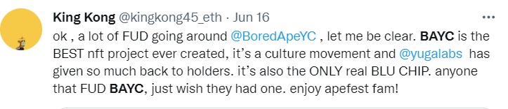
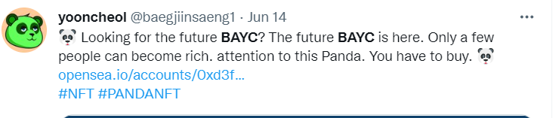
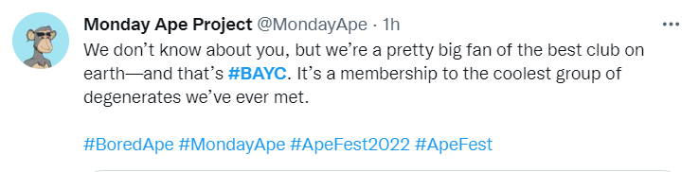
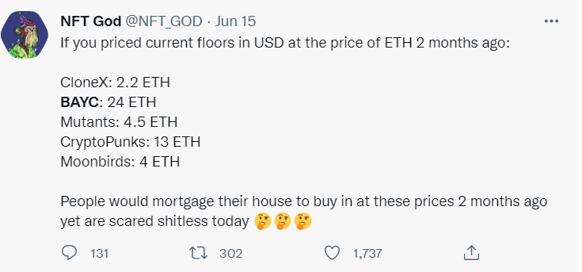
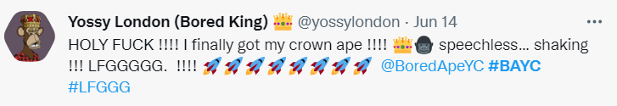
What the Tweet!

Slide 5
Step 1: Obtain twitter API Keys and collect the data (tweets) using tweepy.
Challenges:
Obtained essential access only
Initially not enough data collected
Determining how to pull the data.
Example: Hashtags, NFT Influencers, Specific NFT accounts
Biased data

Slide 6

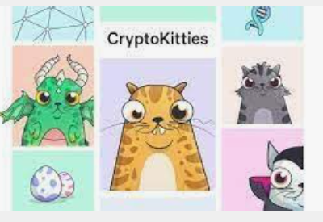

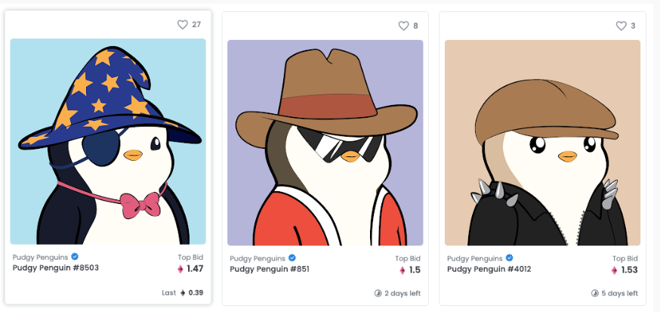
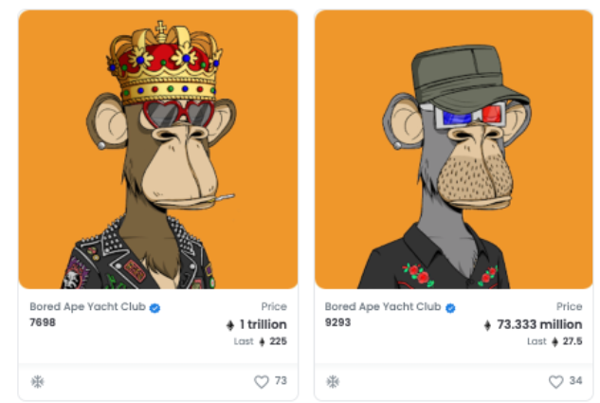
From these 5 collections, BAYC was selected to use for project 2.

Slide 7
Step 2 Clean the data (40 000 tweets) using NLTK
Challenges:
Very messy data
Emoji’s, links,Hastags,bots
Duplicates
Non-English words
Misspelled words
Time

Slide 8
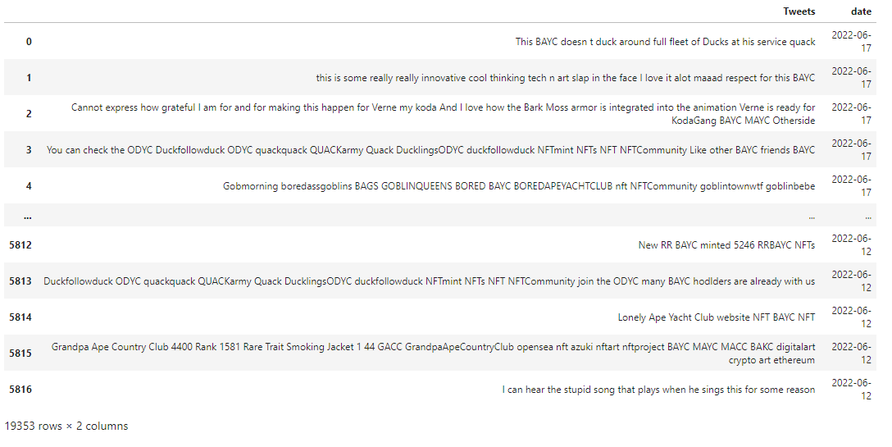
Step 2 Clean the data (40 000 tweets) using NLTK
Challenges:
Very messy data
Emoji’s, links,Hastags,bots
Duplicates
Non-English words
Misspelled words
Time

Slide 9
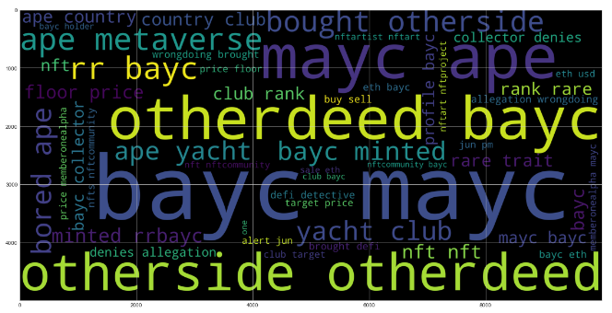

Slide 10

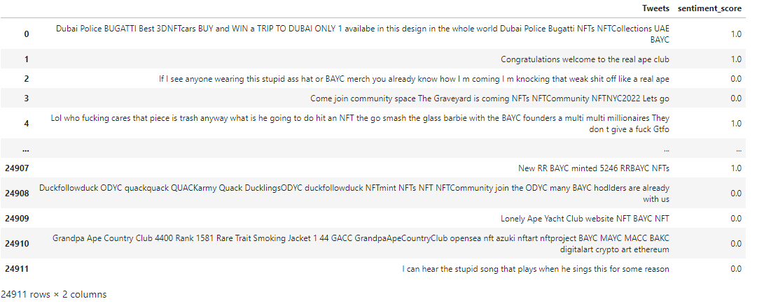
Step 3 Used Vader Sentiment Intensity Analyzer to get the sentiment of tweets. Classify the sentiment as positive/non-positive based on compound score >0.1

Slide 11
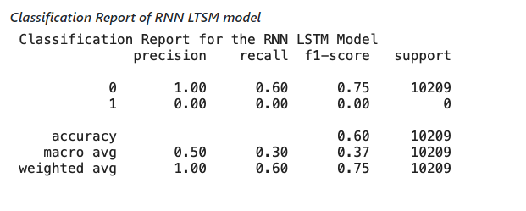
Step 4 Used classified data for training the RNN LSTM model to classify future tweets.
Challenges:
Model did not work well. It should have been able to classify the data better than the Vader sentiment analysis, but this was not the case.
The model was not identifying true positives correctly on the test data.
Therefore, it was not used.

Slide 12
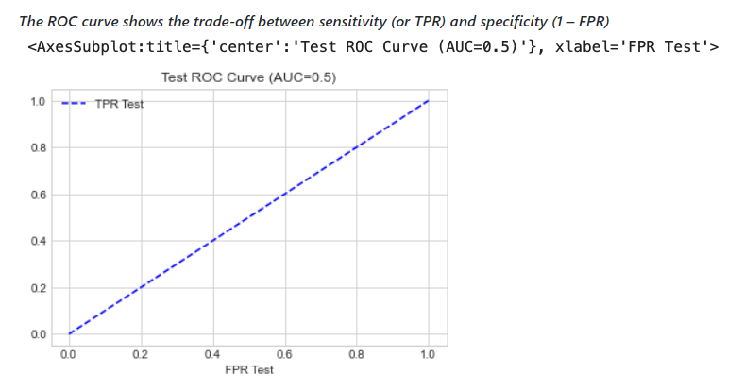
Step 4 Used classified data for training the RNN LSTM model to classify future tweets.
Challenges:
Model did not work well. It should have been able to classify the data better than the Vader sentiment analysis, but this was not the case.
The model was not identifying true positives correctly on the test data.
Therefore, it was not used.

Slide 13

Expectations vs Reality

Slide 14
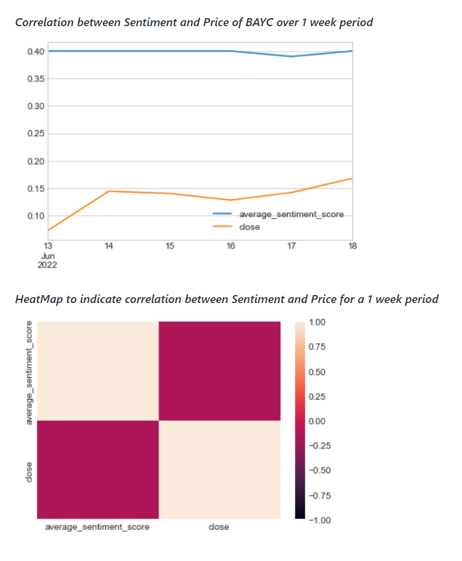

Reality
This project generated real time sentiment analysis of twitter NFT tweets to determine any correlation with the closing price of the NFT collection, Bored Ape Yacht club (BAYC) over a one-week period.
Hypothesizing that there would be a positive correlation. As positive sentiments increased prices would also increase.
The price for the BAYC collection for 1 week was fetched from OpenSea using API provided by OpenSea
Insufficient data to determine correlation

Slide 15
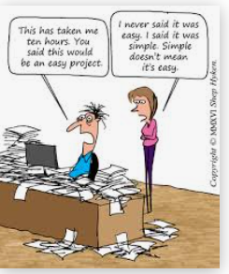
Findings, Conclusions and Recommendations
Findings:
Sentiment Analysis in twitter is not easy ☺
We were not able to identify the sentiment of the market accurately as our data was limited.
Data cleanup process can be time consuming
It is important to run various tests with the data
There are many approaches that can be followed
The RNN LSTM model to classify tweets was not the best approach for us
Recommendations:
Explore different methods to measure sentiment from tweets: e.g., Ngrams
Conduct a manual cleanup of tweets
Use Machine learning to predict future prices of NFT in combination with sentiment analysis
Expand data sources and time horizon
Expand MVP to include other top NFT collections
Final thoughts: At this point, the model is showing that it is not working for the data we currently have; However, we cannot say that the model doesn’t work. The team needs to conduct additional exploration of data sources, and more tests to see if we could get a different result.

Slide 16

Questions:

